Slide 1



Our Class Motto!
"You have brains in your head.
You have feet in your shoes.
You can steer yourself any direction you choose."
Our School's Values
Care - Respect - Community

Slide 2
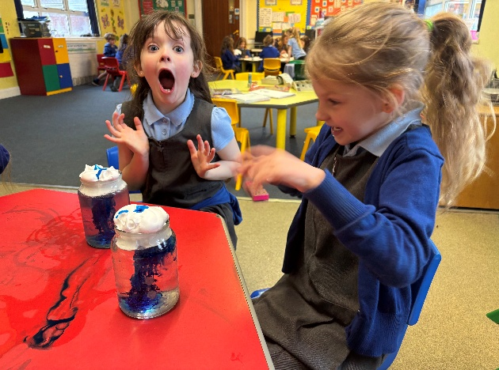
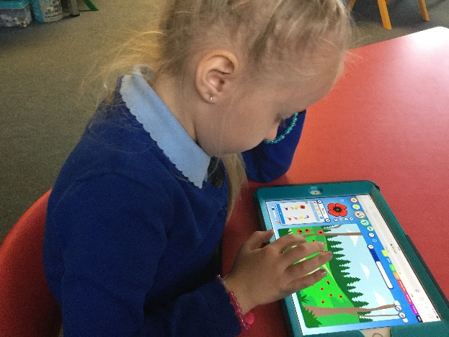

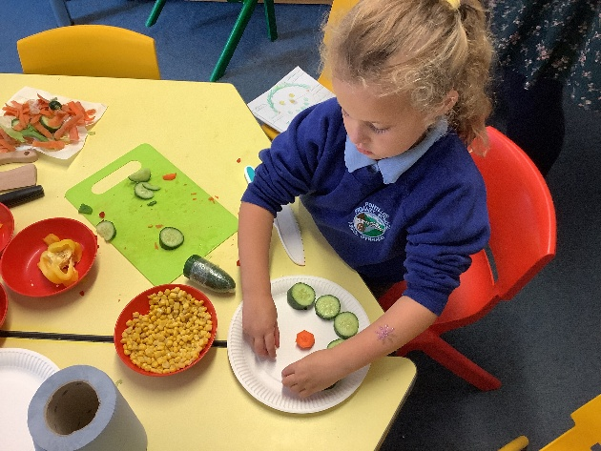
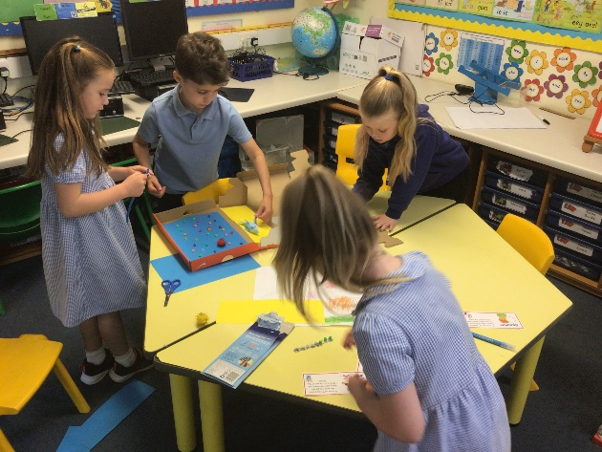
Welcome to Year 1!
Dosbarth Fir

Slide 3

Aims of Year 1!
To provide a balanced and stimulating curriculum through the exploration of ‘Big Questions’, differentiated to suit the needs of each child.
To build on pupil’s social skills through communicating and working with others.
To develop the children’s level of independence and maturity.
To develop the children’s confidence.
To ensure that the children are happy and continue to develop a love of learning!

Slide 4
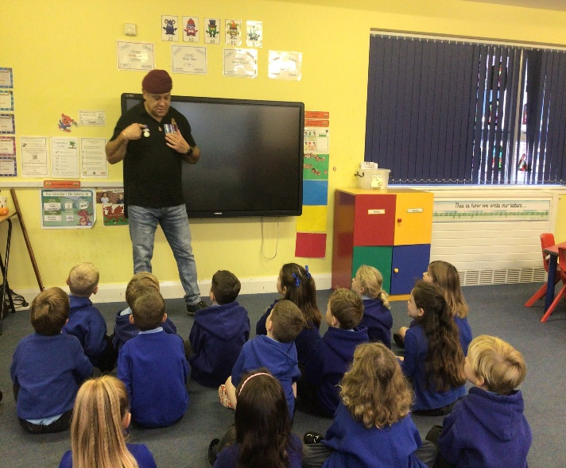
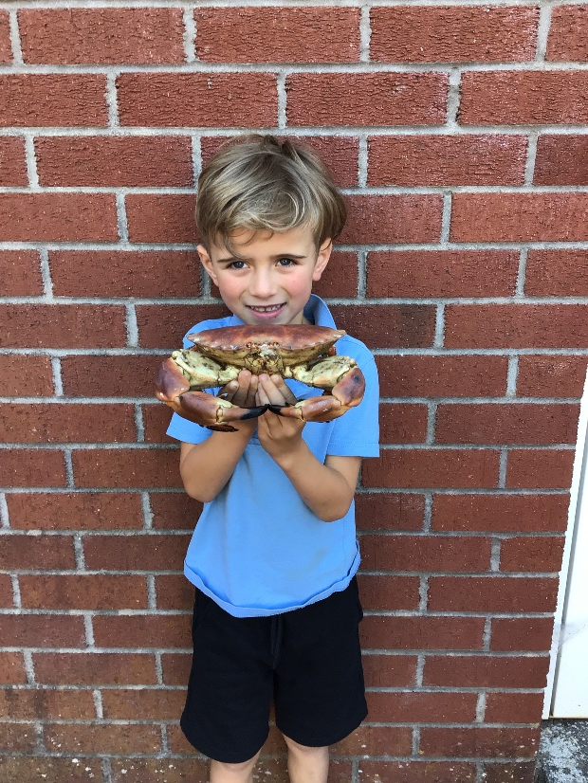

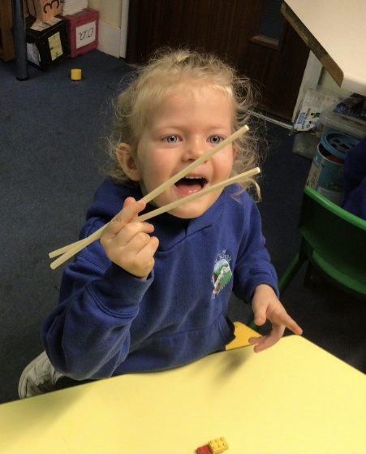


Big Questions
During Year 1 the children will be widening their learning opportunities through the use of ‘Big Questions’.
Our Big Questions in Year 1 will be:
Do all Superheroes wear capes?
Where in the World am I?
What is causing the commotion
in the ocean?

Slide 5
Curriculum for Wales- Areas of Learning and Experiences.
As well as Literacy, Numeracy and Digital Skills, there are 6 Areas of Learning and Experience. Everything your child learns will be connected to these areas.
The 6 AoLEs are:
Health and Wellbeing.
Languages, Literacy and Communication.
Mathematics and Numeracy.
Science and Technology.
Humanities
Expressive Arts

Slide 6

Health and Well-Being: RSE
Our priority in Pontlliw is that our pupils are happy, safe and healthy, therefore it is important they learn about topics such as, healthy relationships, keeping safe, and that they are confident to raise issues with responsible adults.
Our RSE curriculum has been co-constructed with all members of our school community, including staff, governors, pupils, parents/carers and external professions such as the school nurse.
Great care has been taken to ensure that all learning within RSE is developmentally appropriate to ensure that pupils are not exposed to things that aren’t appropriate to their age and development.

Slide 7
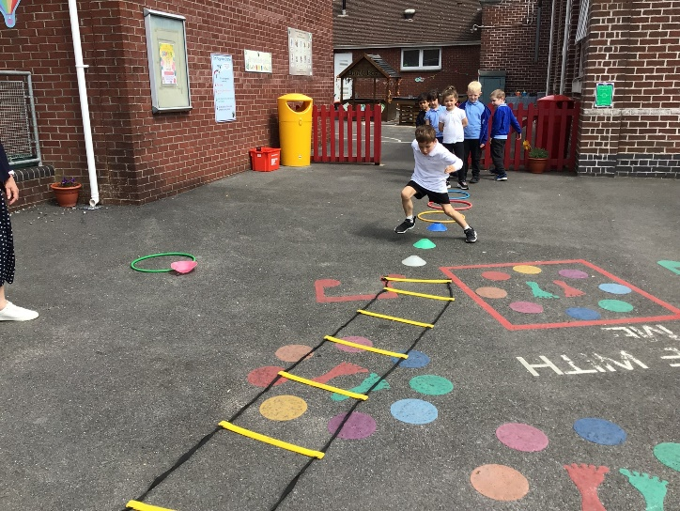
Health and Well-Being- PE Lessons
The children will undertake a lot of physical activity; whether that be during PE sessions, creative movement lessons or when learning outdoors.
PE Lessons:
Days Thursday outdoor & Friday indoor (TBC)
Please can you ensure that your child wears appropriate P.E. kit to school on these days.
All jewellery needs to be removed and long hair should be tied back.

Slide 8
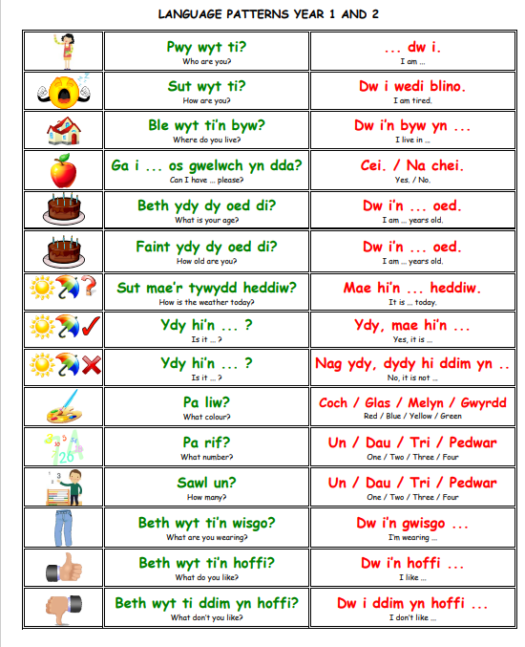
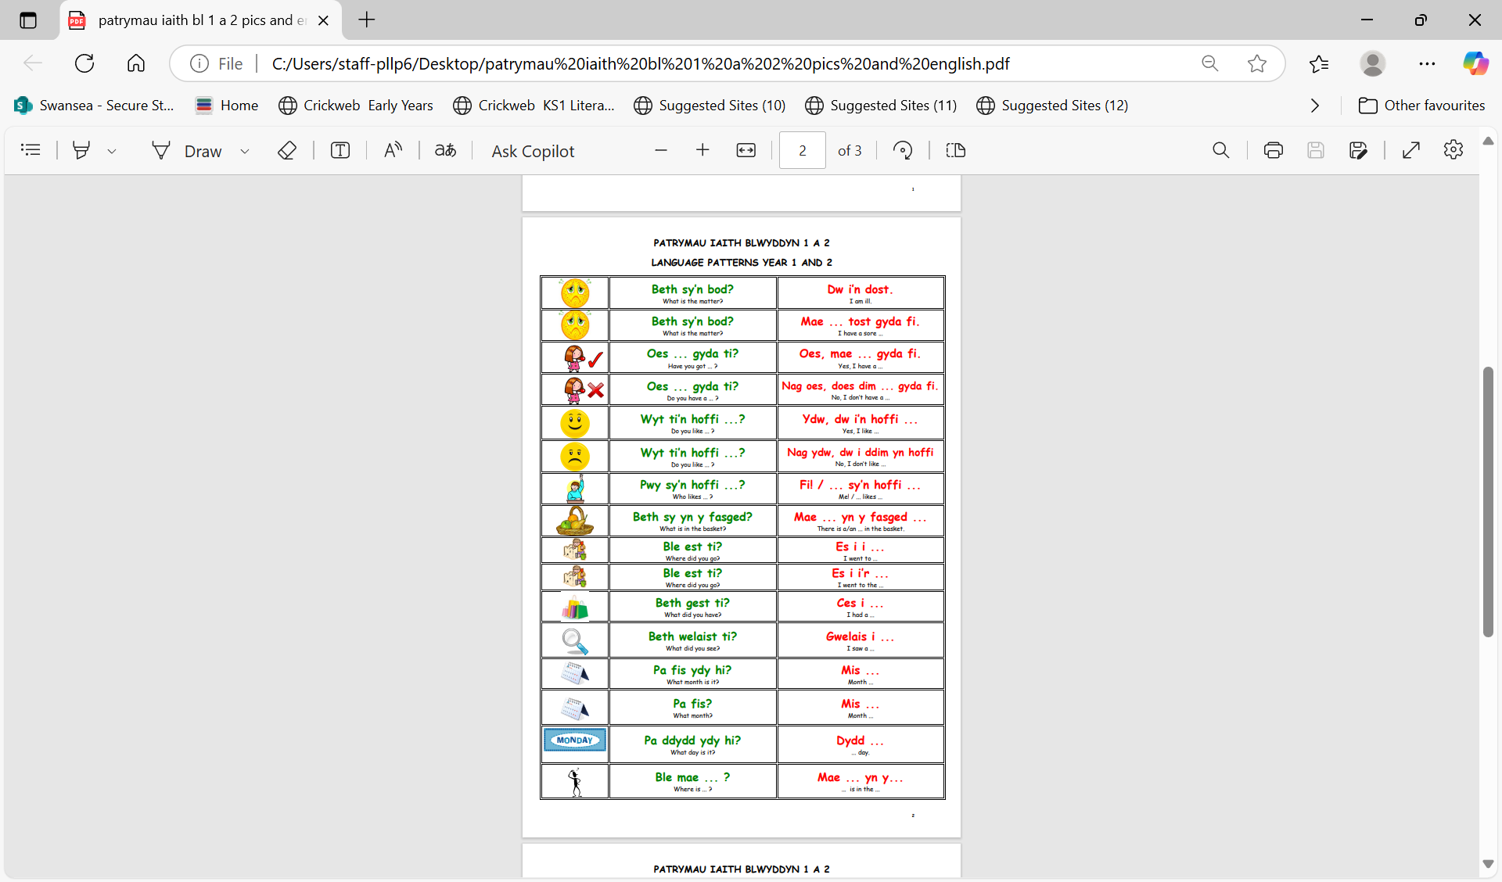
LLC: Welsh

Slide 9
Progression
Progression in learning is a process of developing and improving in skills, knowledge and understanding over time. All children progress at different rates and the pace at which they progress will be individual to the learner.
The Progression Steps
The Curriculum for Wales uses Progression Steps to guide learning and assessment across different age ranges and Areas of Learning and Experiences. They provide a framework for understanding the development of skills and knowledge over time.
The steps roughly correspond to ages 5, 8, 11, 14, and 16. Here are how our classes align with the Progression Steps.
Progression Step 1: Nursery and Reception
Progression Step 2: Years 1, 2 and 3.
Progression Step 3: Years 4, 5 and 6.

Slide 10
Assessment
Assessment plays a fundamental role in enabling us to support children to make progress at a pace that is appropriate to them, ensuring they are supported and challenged accordingly. It should contribute to developing a holistic picture of your child- their strengths, the ways in which they learn and their areas for development- to inform next steps in teaching and learning.
Assessment has three main roles in the process of enabling children’s progression. It provides us with information so that we can:
Support individual children on an ongoing, day-to-day basis.
Identify, capture and reflect on individual children’s progress over time
Understand the progress of different groups of children in order to reflect on practice.

Slide 11
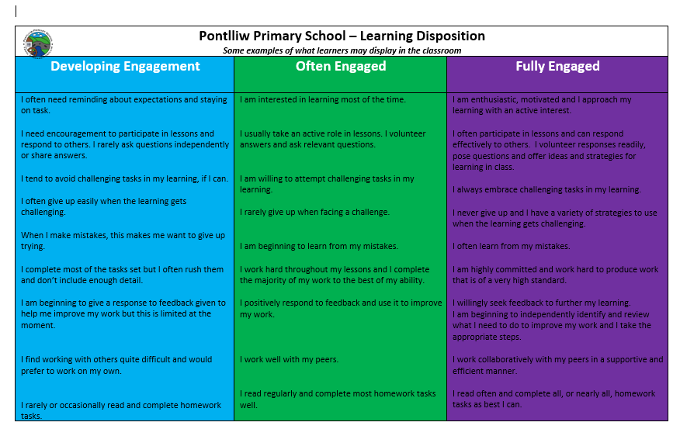
Learning Dispositions
Learning Dispositions are the attitudes, habits and tendencies that shape how individuals approach learning. Strong learning dispositions can strongly enhance a learners ability to acquire new knowledge and skills, adapt to new situations and become a lifelong learner.

Slide 12
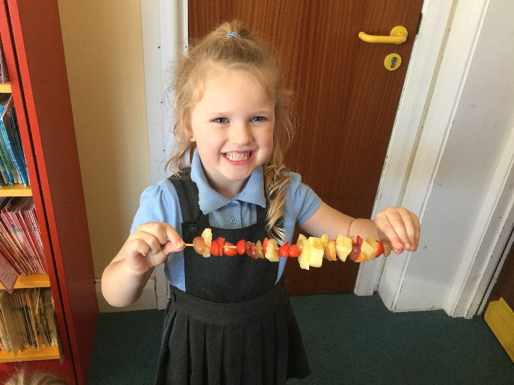
Health and Well-Being- Healthy Habits
In Pontlliw, we have been part of the Healthy Schools initiative for many years. We aim to encourage the children to make healthy choices and understand the importance of a healthy lifestyle.
Morning Snack: your child will need a healthy snack and drink, e.g. fruit, vegetables, water.
Tropical Tuesday: A range of fruit is available to purchase from school on a TUESDAY for 30p. Your child will need to bring the money into school on the day.

Slide 13

j2stars
j2stars allows the children to:
Modify their own avatar to suit their preferences.
Gain stars for positive behaviour within class e.g. being kind, showing resilience, trying their best.
Gain a prize for every set amount of points.

Slide 14

Pupil Voice Groups.
The children will continue to be a part of a pupil voice group next year.
The Pupil voice groups are:
Eco Warriors
Healthy Heroes
Digital Dragons
Criw Cymraeg
Safety Soldiers
Diversity Developers

Slide 15

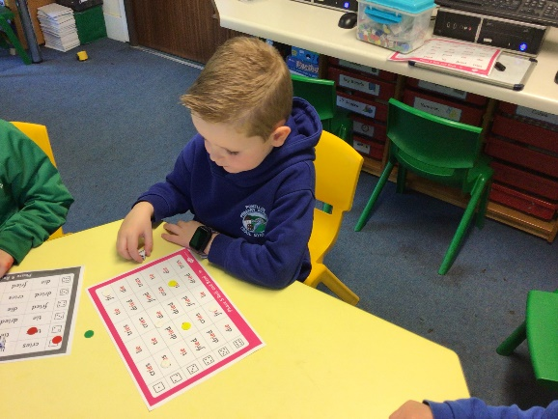
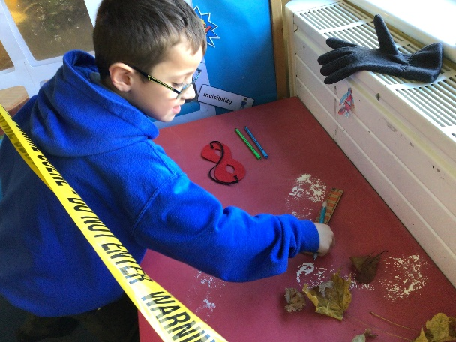
HOMEWORK
Spelling Homework
The children undertake fun spelling activities in class that incorporate their specific group of spelling words.
Spelling pattern words will be given out fortnightly.
Spelling high frequency words will be given out half termly.
Mathematics Homework
The children will be set Maths homework every Friday.
Reading
It is important that your child brings their reading book to school every day. Please comment regularly in your child’s reading diary as your feedback is beneficial.

Slide 16

Working Together
Our staff are very much looking forward to continuing working with you to ensure that the children have a fun, happy and productive time in Year 1.
Helping your child become more independent.
Ensuring the children complete their homework/reading regularly.
Sharing any important information about your child with the class teacher e.g. any new medication.
Helping us enrich our curriculum by coming into school to share information about different topics/areas.

Slide 17
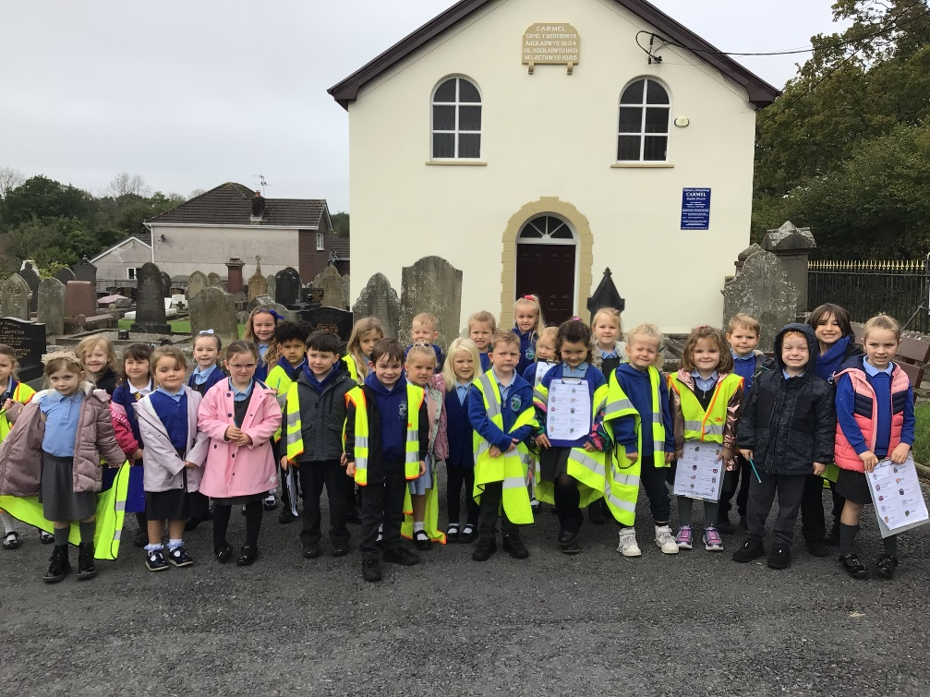

Thank you for listening!

