Slide 1

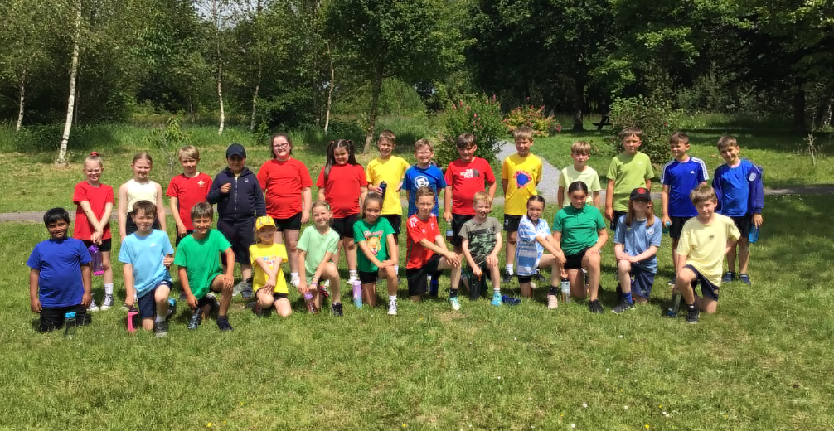
Pontlliw Primary School
“A ship in port is safe…but that’s not what ships are built for.”
Year 4 Parents Information

Slide 2

Aims of the school
Respect - Parch
Care - Gofal
Community - Cymuned

Slide 3
Aims of Year 4
To build on independent working skills from Year 3
To build on previous skills, focusing on Literacy, Numeracy and DCF across the curriculum
Develop group working and problem solving skills through mixed approach activities, including concrete and diagrammatic approaches
Build confidence in terms of oracy and speaking in class
Further develop ICT skills through independent and collaborative working

Slide 4

Reward Systems
Important to build confidence and self belief
Class Dojo – termly prizes to incentivise all children.

Slide 5

Pupil Voice
Every child will be assigned to a pupil voice:
Criw Cymraeg
Safety Soldiers
Health and Well-being
Digital Dragons
Diversity Developers
Eco Warriors

Slide 6
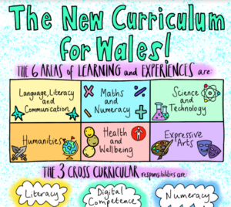
Aole's
There are 6 area's of learning, linked to the new curriculum.
LLC – Language, Literacy and Communication
MN – Mathematics ad Numeracy
HWB – Health and Well-being
EA – Expressive Arts
ST – Science and Technology
H – Humanities

Slide 7
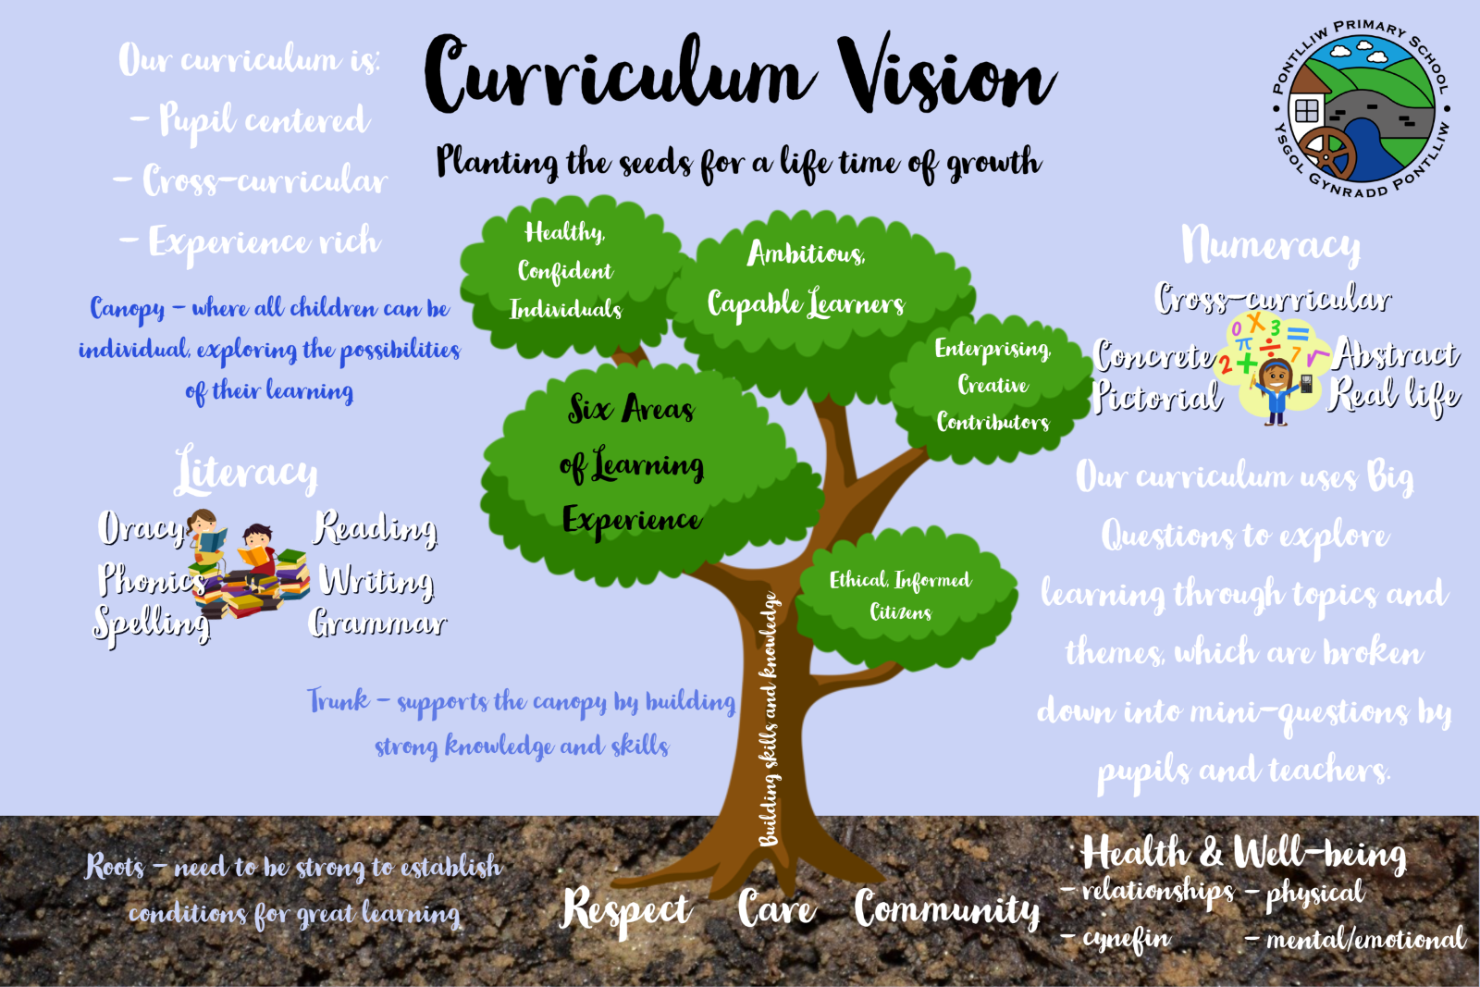
Brilliant Branches
Tremendous Trunks
Starting Seeds

Slide 8
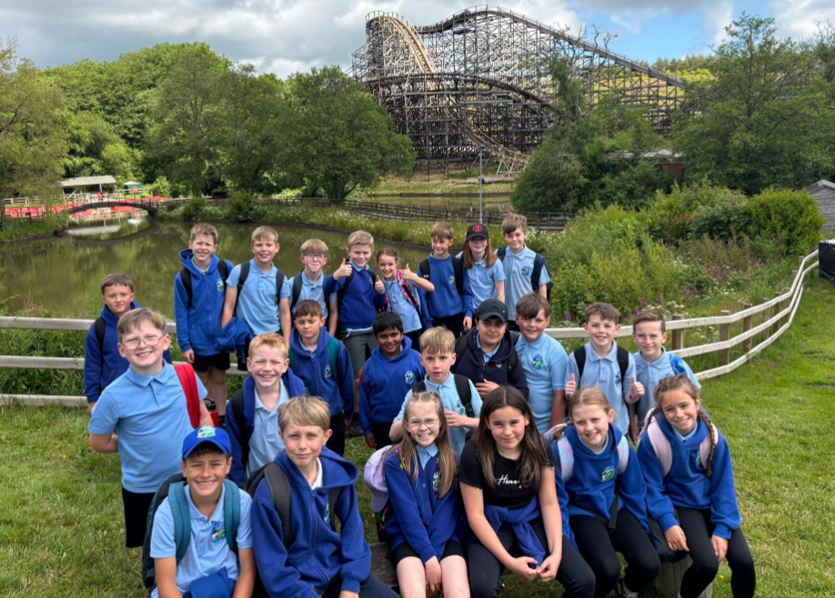
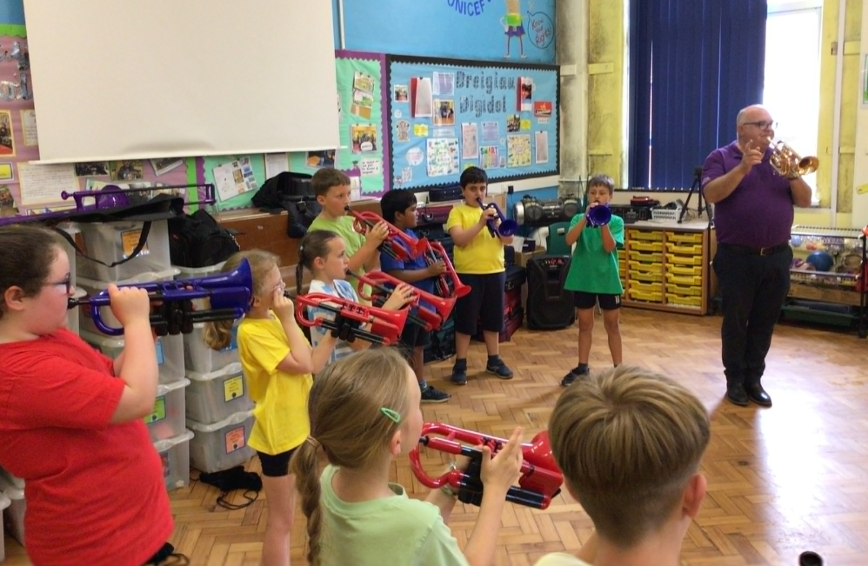
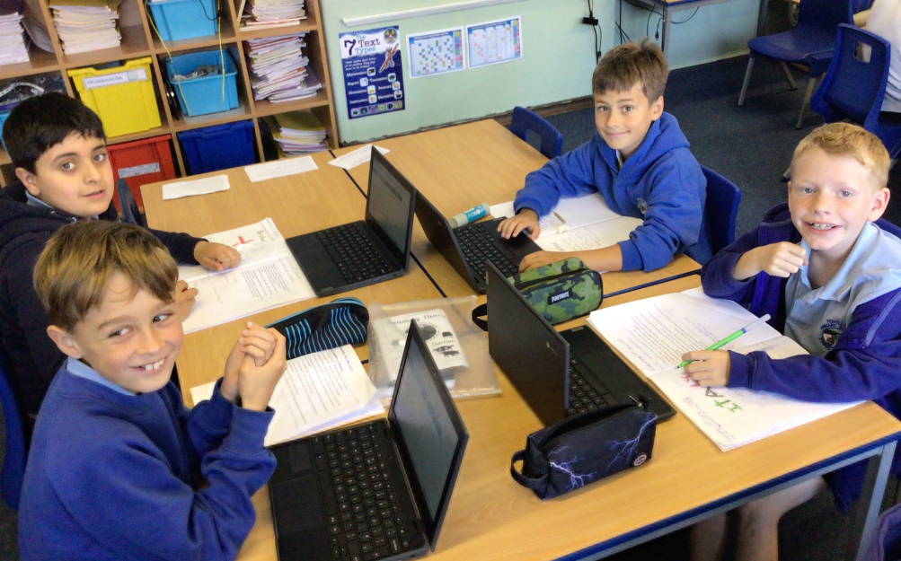
Big Questions
This year, we are going to broaden our learning opportunities through the use of “Big Questions” as a starting point.
Autumn term – Why do we travel?
Wild West and the Pioneers, mountain travel and tourism.
Spring term – Can people be replaced?
Circuits, robots, AI.
Summer term – Why do we push ourselves to the limit?
Mountains, volcanoes, extreme sports and athletes.

Slide 9

Health and Well-Being: RSE
What is RSE?
Our priority in Pontlliw is that our pupils are happy, safe and healthy, therefore it is important they learn about topics such as, healthy relationships, keeping safe, and that they are confident to raise issues with responsible adults.
Parents have a central role to play in supporting their children, however there is also a crucial role for schools - especially in a world where there is so much inaccurate and misleading information and harmful materials, circulating online. Our RSE curriculum is designed to safeguard all our children, supporting them to develop knowledge, skills and behaviours that will assist in protecting them throughout their lives. ​

Slide 10

Health and Well-Being: RSE
Our RSE curriculum has been co-constructed with all members of our school community, including staff, governors, pupils, parents/carers and external professions such as the school nurse.
Great care has been taken to ensure that all learning within RSE is developmentally appropriate to ensure that pupils are not exposed to things that aren’t appropriate to their age and development.

Slide 11

Daily Timetable
First Lesson - Literacy
Second Lesson – Mathematics
Welsh Drilling Sessions – 10minutes every afternoon
Afternoon lessons – Big Question based and Missions & Bubbles

Slide 12
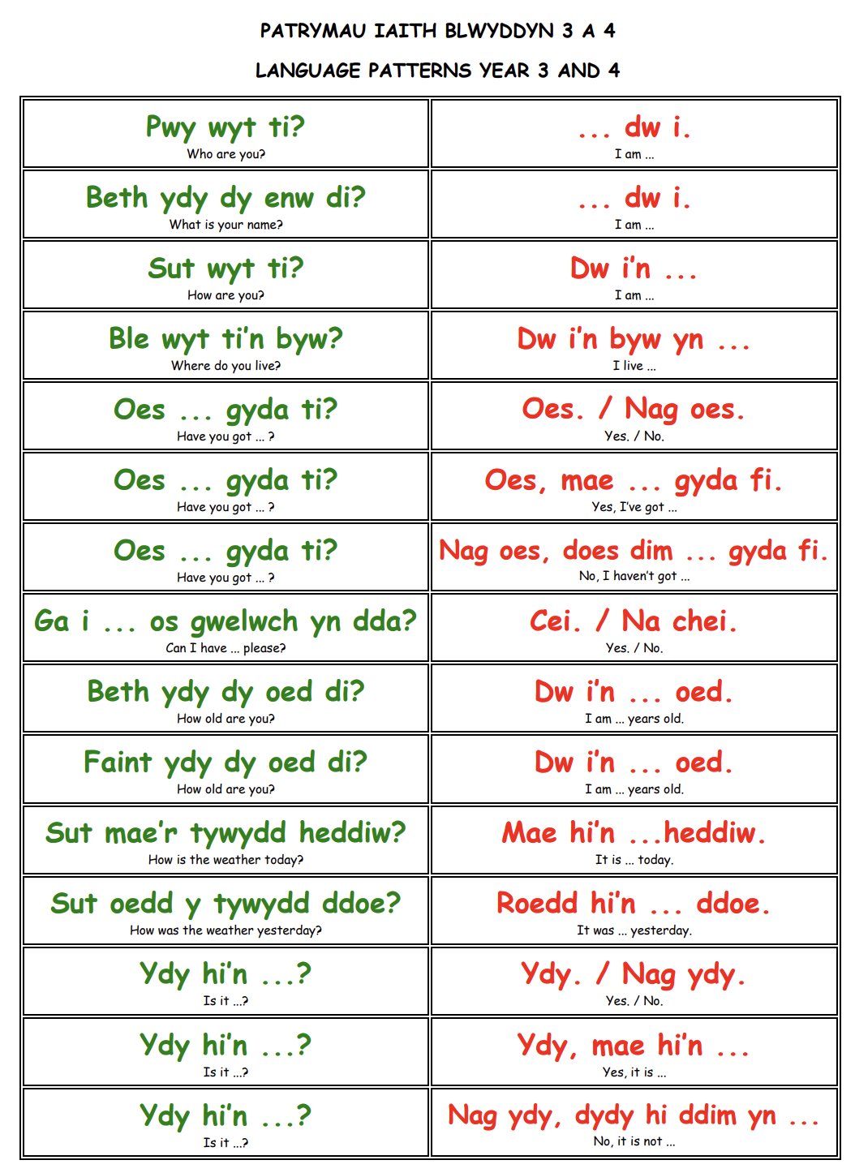
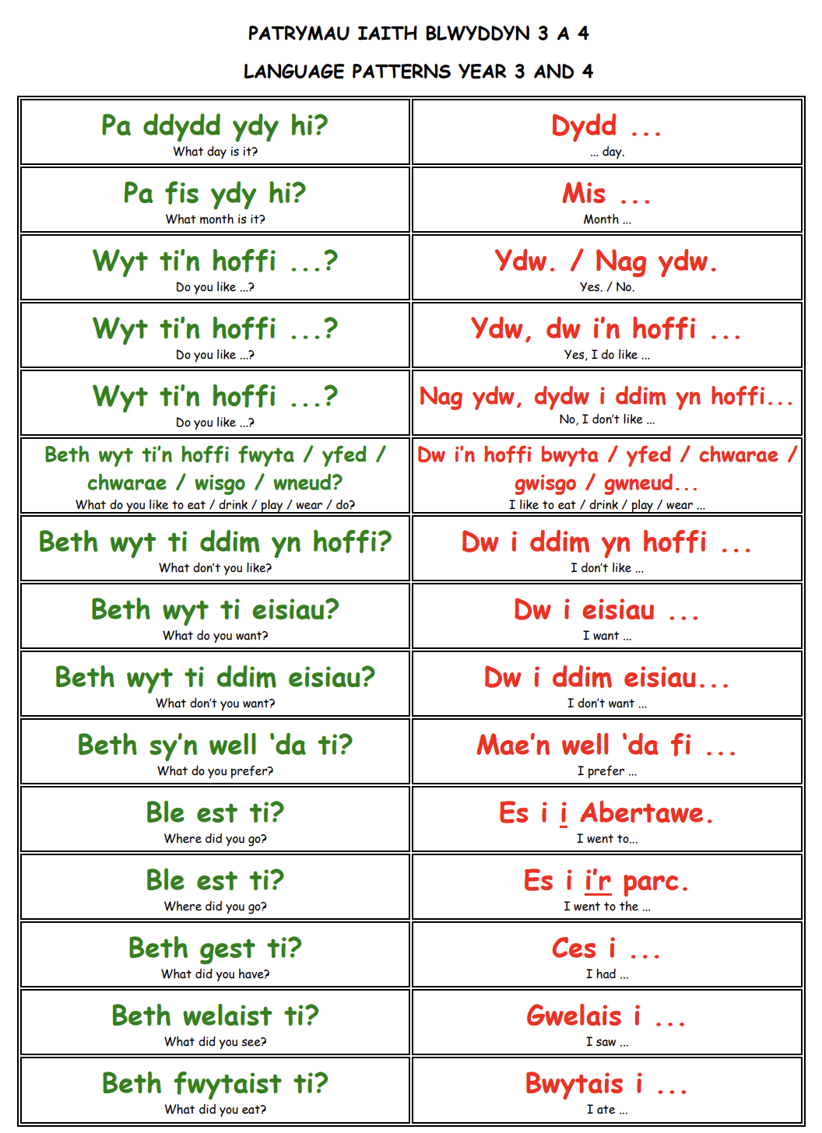

Slide 13
PE Days
PE days to be confirmed: (possibility of Swimming)
PE kit information:
PE Kit –Suggested clothing for P.E. is navy jogging bottoms/ shorts, white polo shirt and trainers. All jewellery must be removed and long hair must be tied back for P.E. Year 4 children are allowed to come to school wearing their kits if they would prefer as it saves time and space with changing.

Slide 14
Working together
Reading – weekly reading
Spelling.
Maths – Weekly timetable recall
Mental Maths Homework books
Sharing information or concerns your child may have

Slide 15

Homework
Spelling lists given out half termly (tested end of term)
Mental Maths continuation
Reading – Ideally daily, or as often as possible
“Helping out” activities

Slide 16
Progression
Progression in learning is a process of developing and improving in skills, knowledge and understanding over time. All children progress at different rates and the pace at which they progress will be individual to the learner.
The Progression Steps
The Curriculum for Wales uses Progression Steps to guide learning and assessment across different age ranges and Areas of Learning and Experiences. They provide a framework for understanding the development of skills and knowledge over time.
The steps roughly correspond to ages 5, 8, 11, 14, and 16. Here are how our classes align with the Progression Steps.
Progression Step 1: Nursery and Reception
Progression Step 2: Years 1, 2 and 3.
Progression Step 3: Years 4, 5 and 6.

Slide 17
Assessment
Assessment plays a fundamental role in enabling us to support children to make progress at a pace that is appropriate to them, ensuring they are supported and challenged accordingly. It should contribute to developing a holistic picture of your child- their strengths, the ways in which they learn and their areas for development- to inform next steps in teaching and learning.
Assessment has three main roles in the process of enabling children’s progression. It provides us with information so that we can:
Support individual children on an ongoing, day-to-day basis.
Identify, capture and reflect on individual children’s progress over time
Understand the progress of different groups of children in order to reflect on practice.

Slide 18
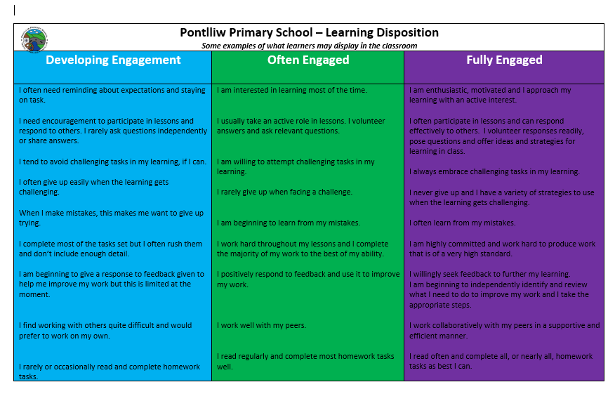
Learning Dispositions
Learning Dispositions are the attitudes, habits and tendencies that shape how individuals approach learning. Strong learning dispositions can strongly enhance a learners ability to acquire new knowledge and skills, adapt to new situations and become a lifelong learner.

Slide 19
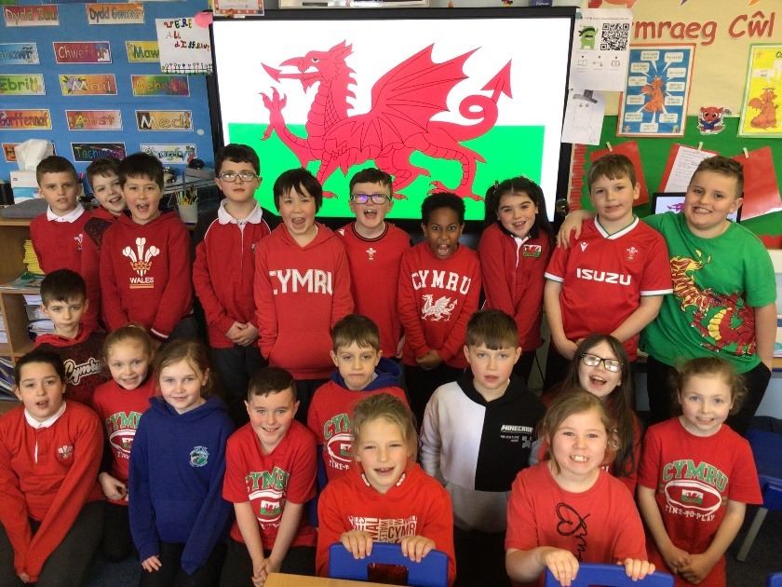
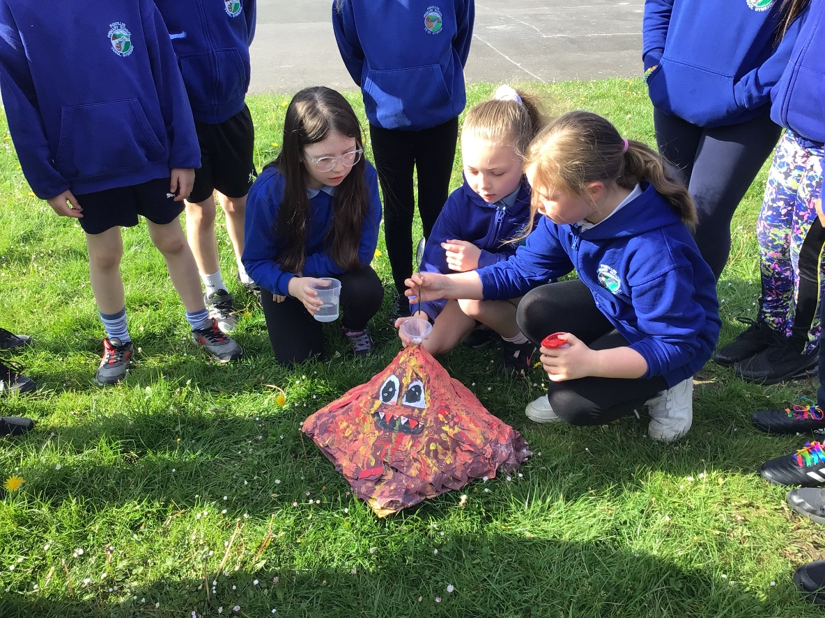
And finally...
Year 4 is an exciting year where the children get to learn about and work with a huge range of interesting topics and equipment – from electrical circuits and the water cycle, to erupting volcanoes and wanted posters.
Thank you for your continued support.

