Slide 1

Ysgol Gynradd Pontlliw
Pontlliw Primary School
“Anything is possible, anything can be”
Year 5 - Blwyddyn 5

Slide 2

Aims of the School
We are very proud of our 3 values;
Respect,
Care,
Community.

Slide 3

Aims of Year 5
For the children to be happy and have a love for learning!
To develop the ability to work collaboratively.
To continue to develop independence and maturity in preparation for Year 6 and beyond.

Slide 4

Areas of Learning
The children will undertake activities and fun learning experiences that explore all 6 Areas of Learning and Experiences.​
The 6 AoLEs are:
LLC – Language, Literacy & Communication
MN – Mathematics & Numeracy
HWB – Health & Wellbeing
EA – Expressive Arts
ST – Science & Technology
H - Humanities

Slide 5
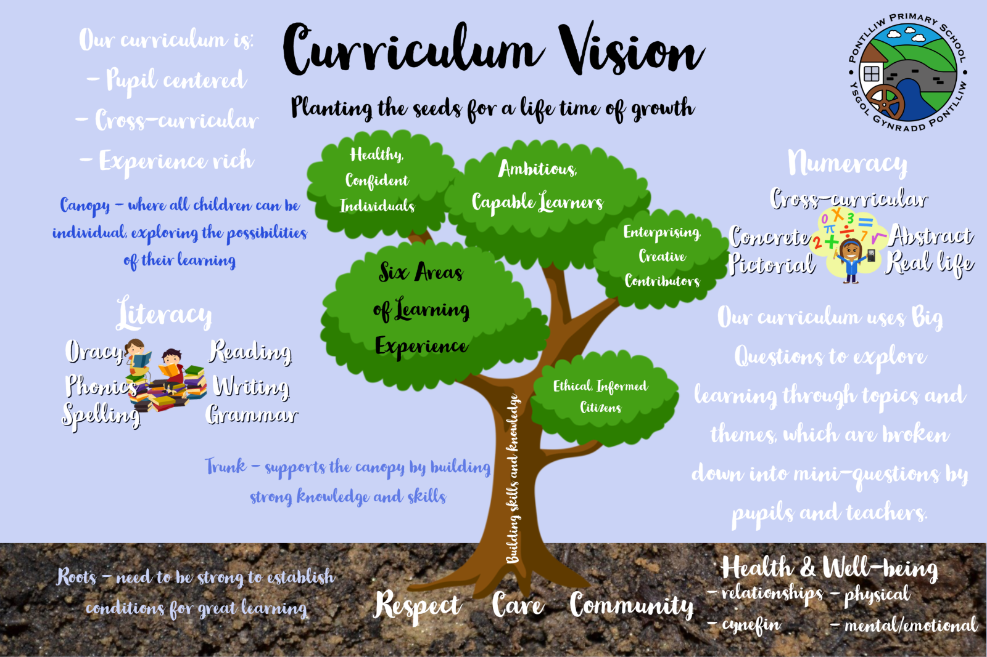
Starting Seeds- Nursery/ Reception
Tremendous Trunks- Years 1, 2 and 3
Brilliant Branches- Year 4, 5 & 6

Slide 6
Assessment
Assessment plays a fundamental role in enabling us to support children to make progress at a pace that is appropriate to them, ensuring they are supported and challenged accordingly. It should contribute to developing a holistic picture of your child- their strengths, the ways in which they learn and their areas for development- to inform next steps in teaching and learning.
Assessment has three main roles in the process of enabling children’s progression. It provides us with information so that we can:
-Support individual children on an ongoing, day-to-day basis.
-Identify, capture and reflect on individual children’s progress over time
-Understand the progress of different groups of children in order to reflect on practice.

Slide 7

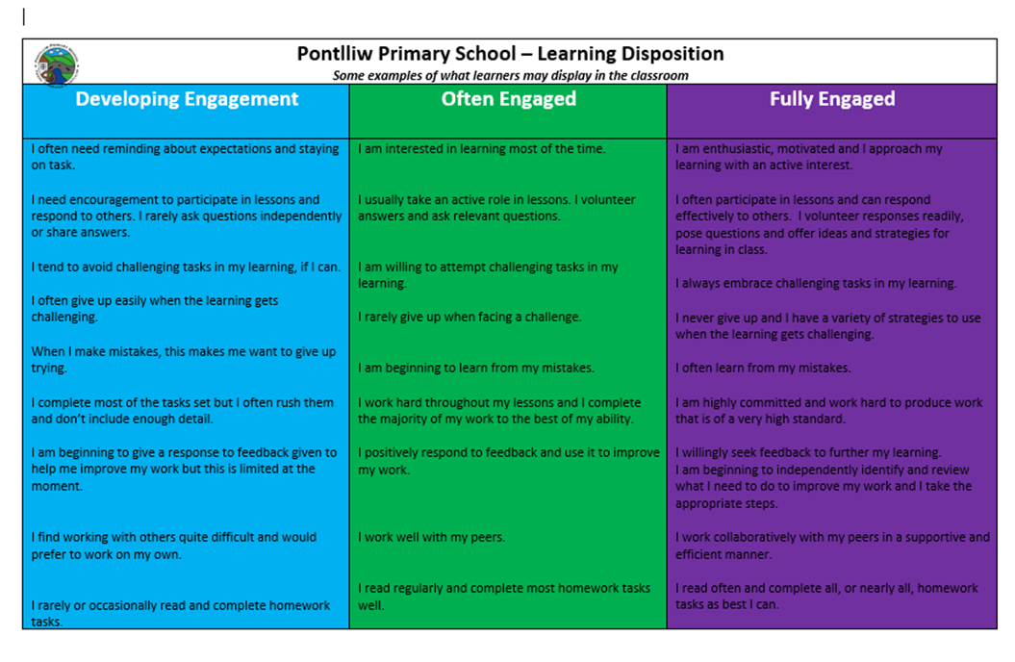
Learning Dispositions

Slide 8
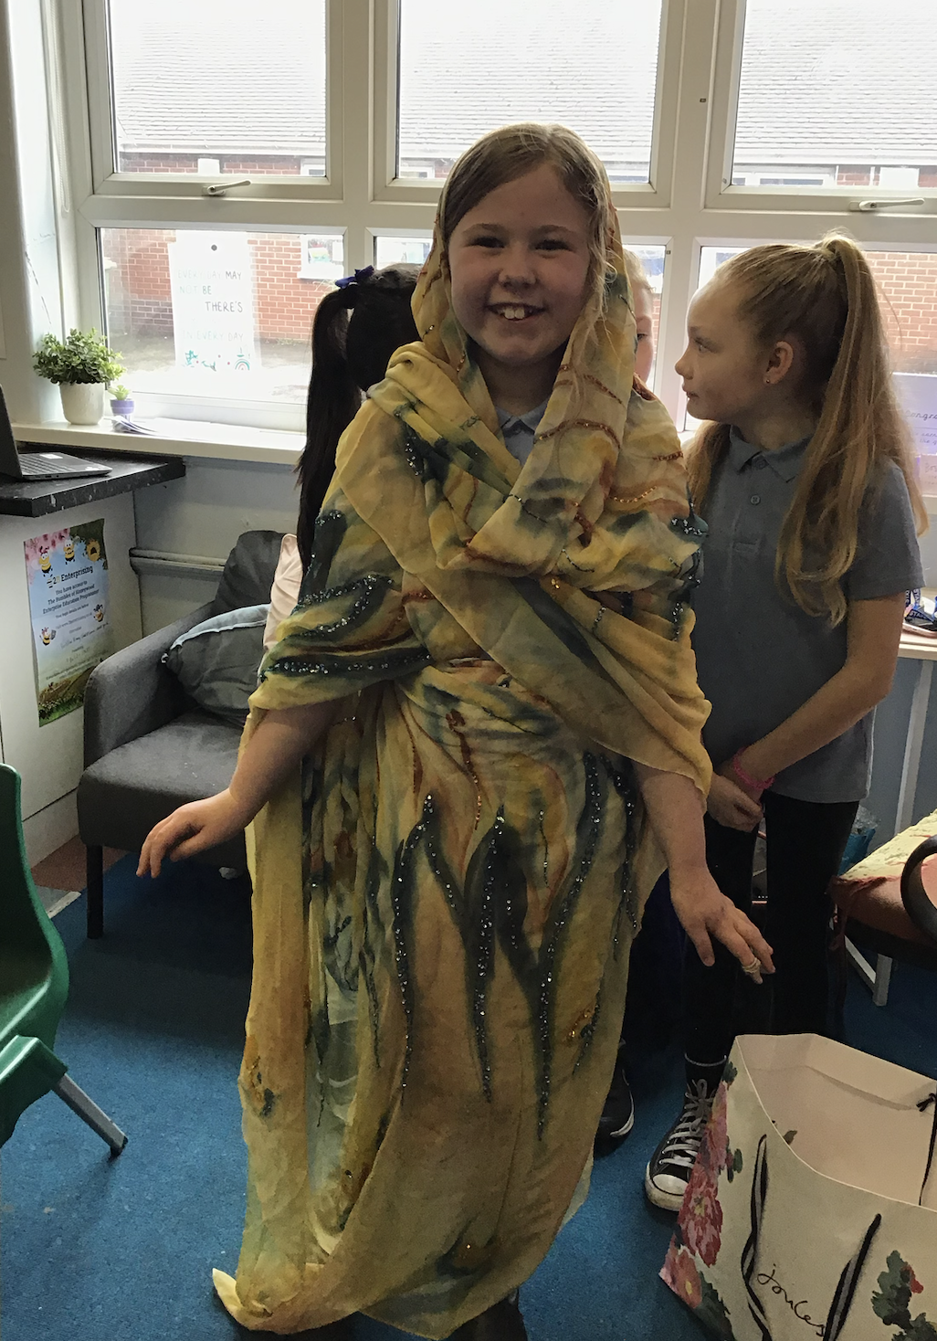
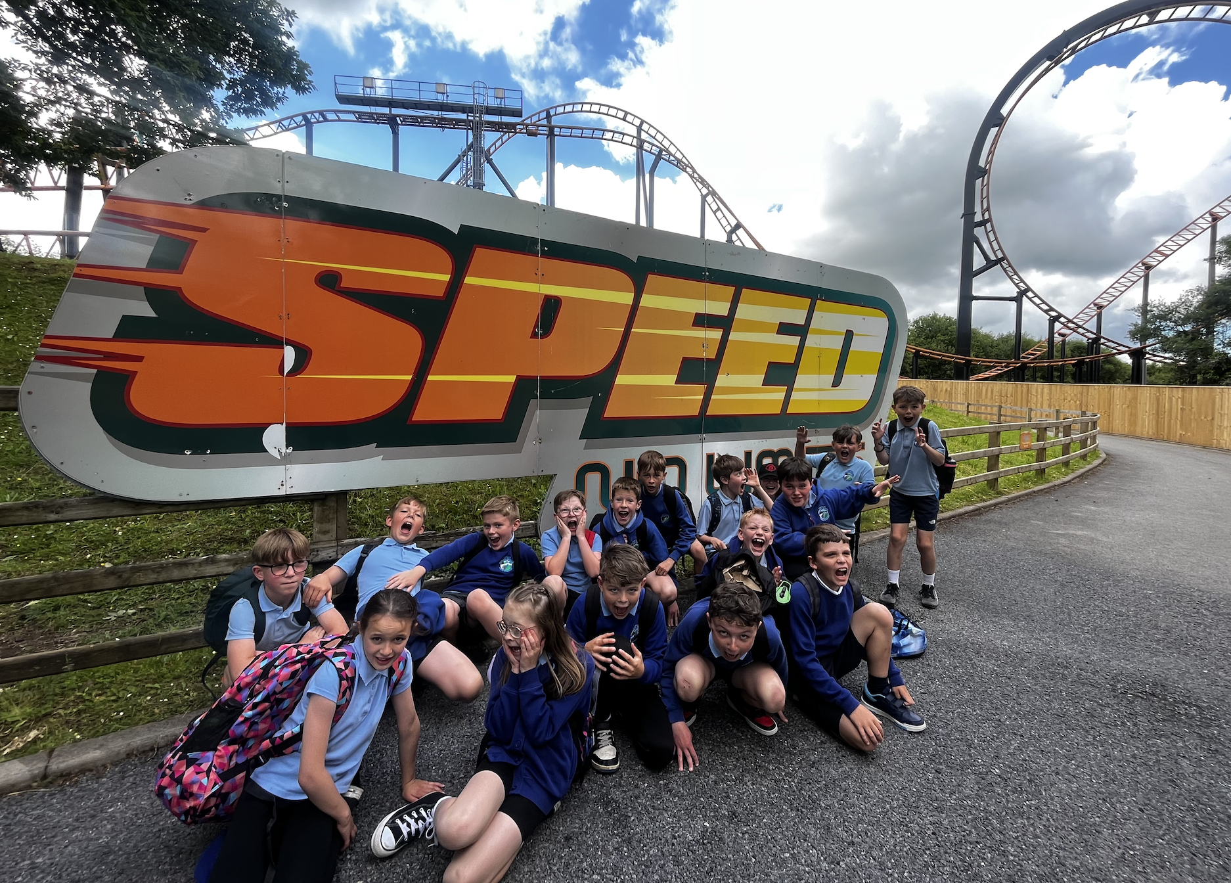
Big Questions
This year we will be broadening our learning opportunities through the use of
“Big Questions”.
Autumn Term
Do we have a greater impact on the world now than in the past?
Summer Term
How do forces affect us?
Spring Term
How does where we live affect us?

Slide 9
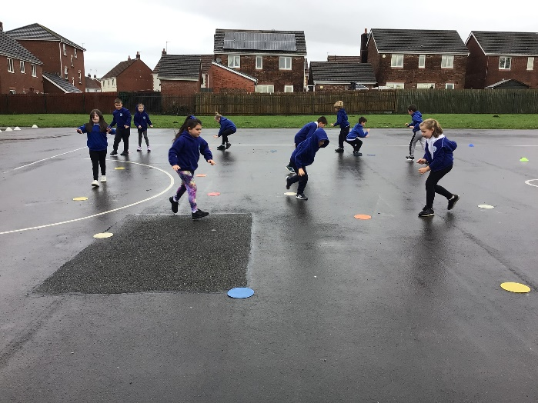
PE
P.E Kit:
Suggested clothing includes navy jogging bottoms/shorts and white polo shirt to be worn. Long hair to be tied back and no jewellery.
Year 5 children are allowed to come to school wearing their kits if they would prefer as it saves time and space with changing.
P.E Sessions:
x2 P.E sessions a week.
P.E days TBC.
*Swimming

Slide 10
Daily Timetable
Morning:
Guided Reading
Mathematics
English
Afternoon:
Welsh Drilling Sessions – 10 minutes every afternoon
Topic Sessions linked to Big questions & Independent Missions
PE sessions

Slide 11
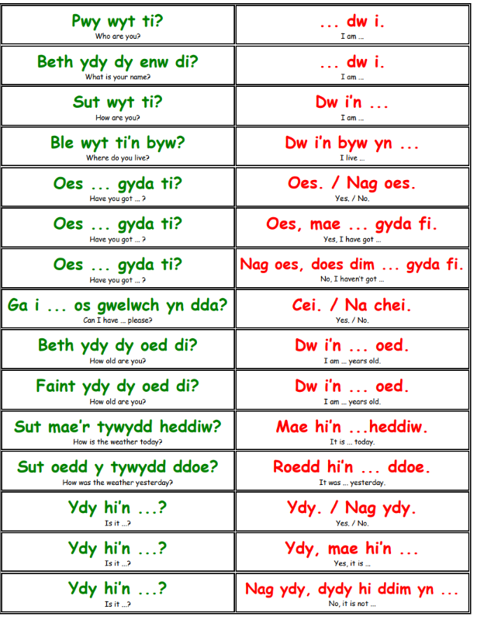
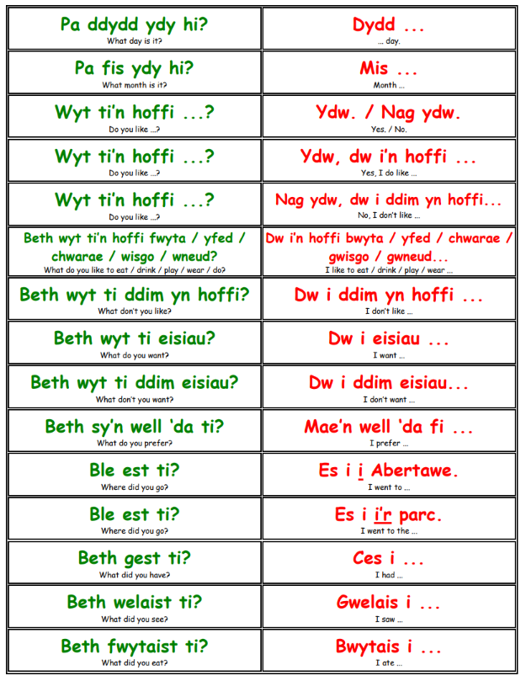
Welsh Language Development

Slide 12

Health and Well-Being: RSE
What is RSE?
Our priority in Pontlliw is that our pupils are happy, safe and healthy, therefore it is important they learn about topics such as, healthy relationships, keeping safe, and that they are confident to raise issues with responsible adults.
Parents have a central role to play in supporting their children, however there is also a crucial role for schools - especially in a world where there is so much inaccurate and misleading information and harmful materials, circulating online. Our RSE curriculum is designed to safeguard all our children, supporting them to develop knowledge, skills and behaviours that will assist in protecting them throughout their lives. ​

Slide 13

Health and Well-Being: RSE
Our RSE curriculum has been co-constructed with all members of our school community, including staff, governors, pupils, parents/carers and external professions such as the school nurse.
Great care has been taken to ensure that all learning within RSE is developmentally appropriate to ensure that pupils are not exposed to things that aren’t appropriate to their age and development.

Slide 14

Working together
Reading – weekly reading ​
Spelling. ​
Maths – Weekly timetable recall​
Mental Maths Homework books ​
and online learning where appropriate​
Sharing information or concerns your child may have

Slide 15
Homework
Spelling lists given out half termly (tested end of term)​
Mental Maths continuation​
Reading – Ideally daily, or as often as possible​
“Helping out” activities

Slide 16


Reward Systems
Important to build confidence and self belief ​
Class Dojo – ensure that you are signed up as children are encouraged to share work themselves

Slide 17

Pupil Voice
Every child will be part of a Pupil Voice group
Criw Cymraeg
Digital Dragons
Curriculum Council
Healthy Heroes
Safety Soldiers
Eco Warriors

Slide 18

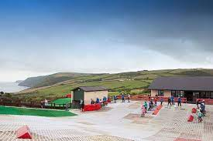
Llangrannog
2 nights in May *TBC
Wide range of activities
Amazing learning experience
£ will be confirmed closer to the time but payment can be made in instalments- plenty of warning.

Slide 19

And finally...
Thank you for your continued support.
I hope your child enjoys their time in Year 5 ☺

